Slide 1
Dynamic action space reduction for reinforcement learning
Vikram Bala – CS 5824

Slide 2
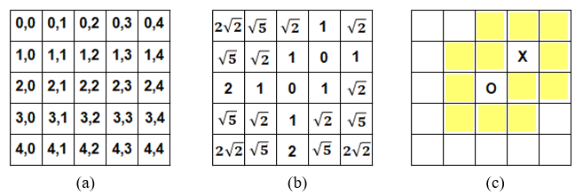
Background
Recreation & adaptation of Woo & Sung (2020) [link]
Reinforcement learning → state-action space can grow incredibly large over time
Can we use spatial data to reduce the action space at each timestep?
Paper: Q-learning on 5x5 Tic Tac Toe

Slide 3
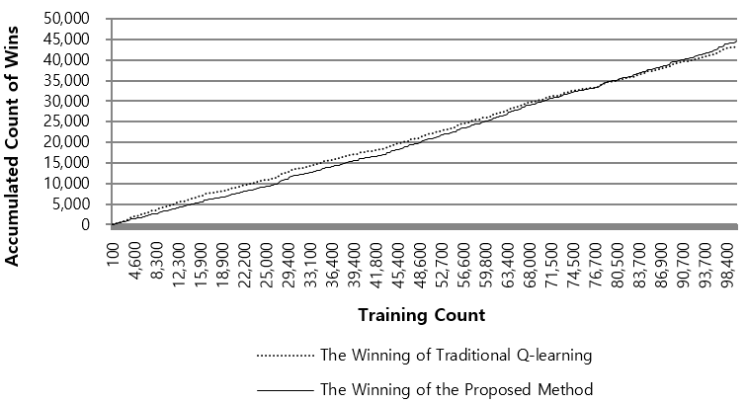
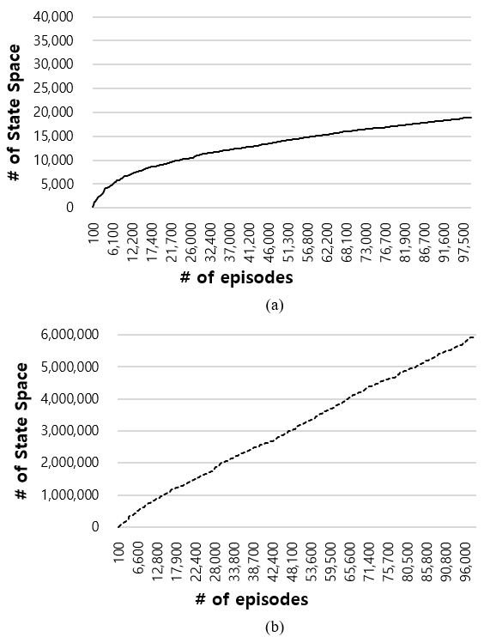
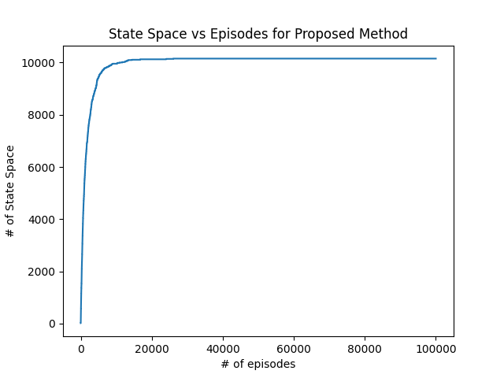
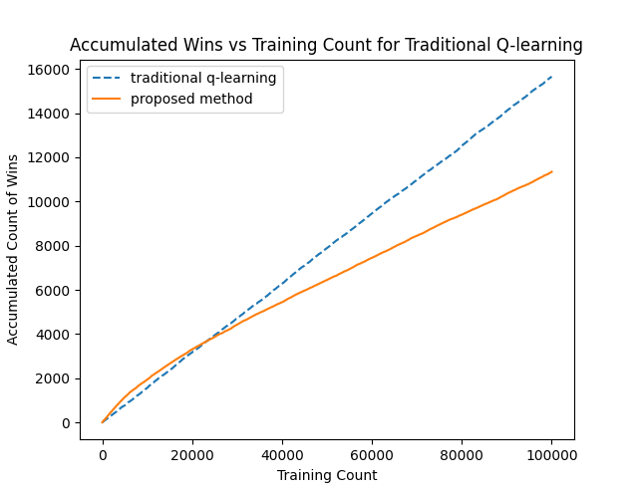
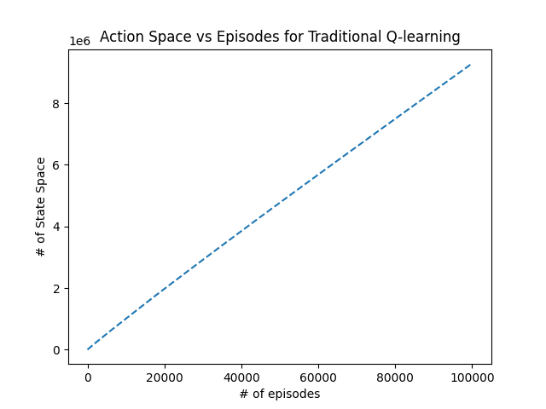
Recreation (5x5 Tic Tac Toe)
(Caps at 4 turns)
Paper
Paper
Mine
Mine

Slide 4
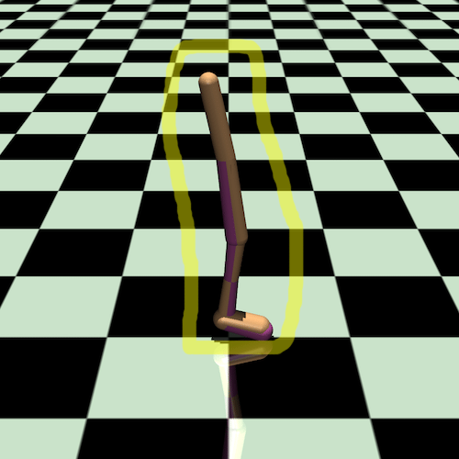
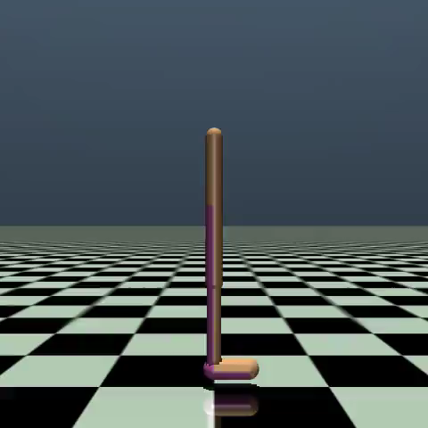
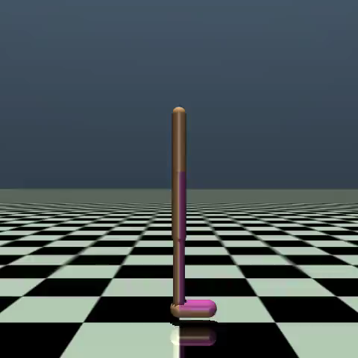
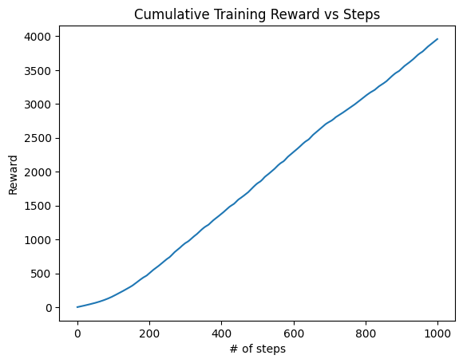
Benchmark
Walker2D (MuJoCo) with PPO (proximal policy optimization) from scratch
Method proved unsuitable for complex use cases (continuous action spaces, function approximation)
Approach: Use bounding box to limit actions
Random, 400 steps
PPO, 1000 steps, 1M timesteps

Slide 5
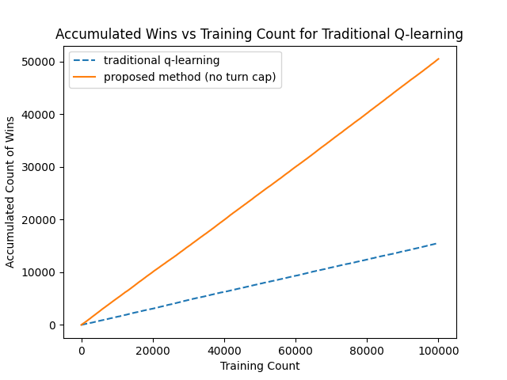
Conclusion
Hard to evaluate accuracy of recreation
Ablation, no defined hyperparameters, no defined exploration method, no defined rewards
Fails for complex use cases
Would have to fundamentally change approach for neural nets
Large action spaces → can learn policy directly instead (e.g. Actor-Critic, PPO)
GitHub repo: link
Ablation of turn cap of 4

